Slide 1
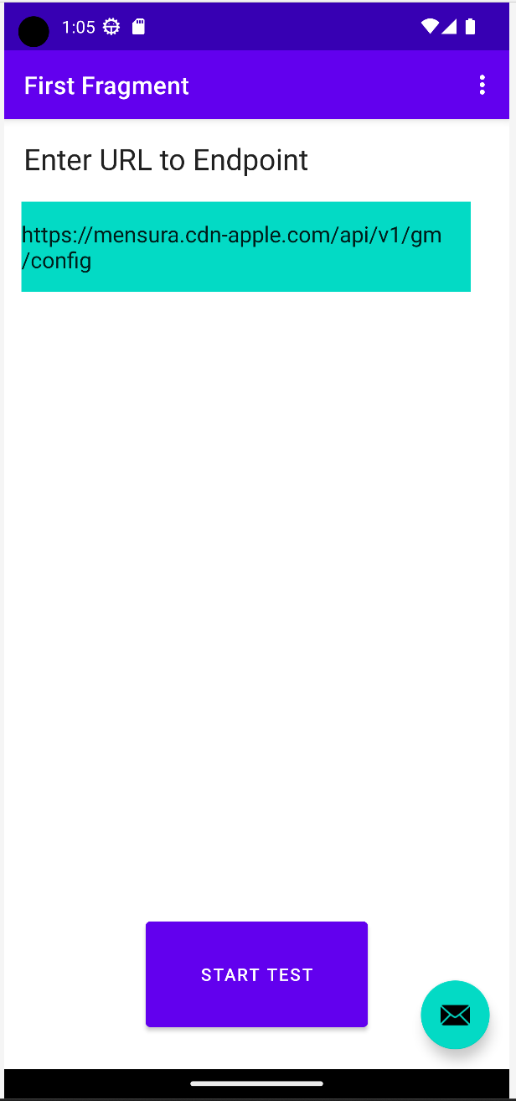
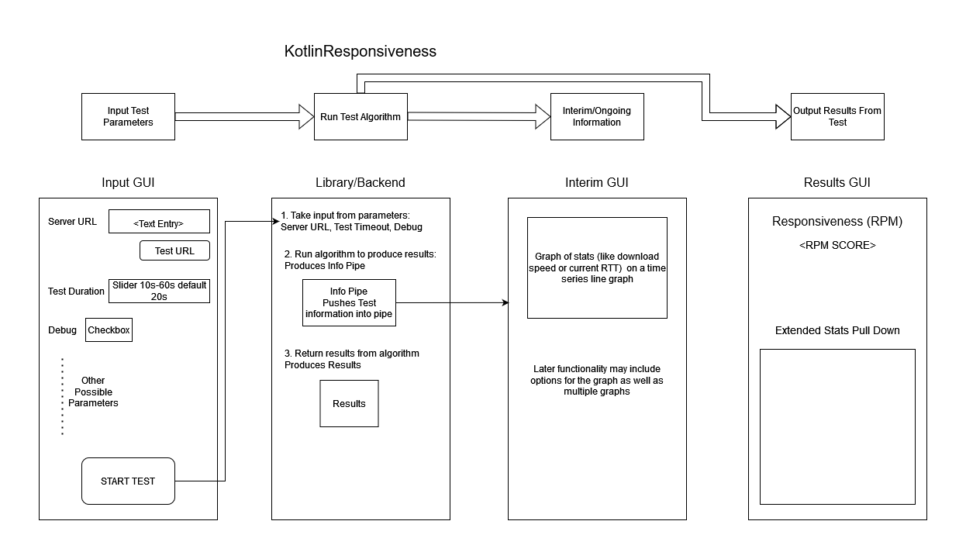
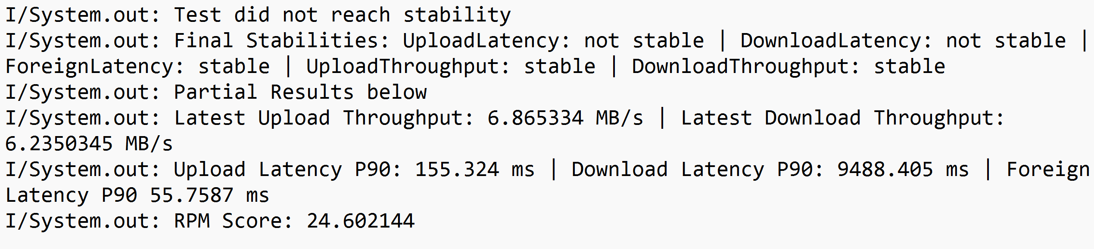
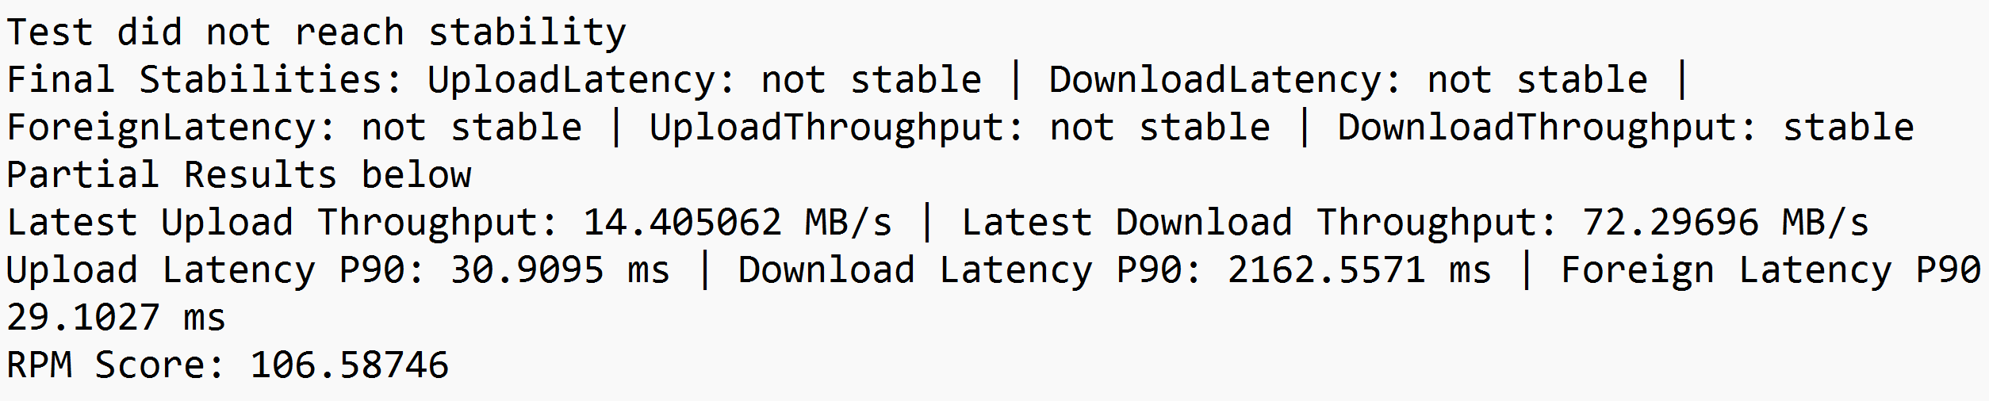
Kotlin Responsiveness
Background
Project by Jeroen Schickendantz
Advisor: Dr. William Hawkins III
Android App Layout
RPM is a measurement of a network connection’s latency that accounts for normal usage.
The aim of the RPM Test is to give users intuitive feedback on their connection's responsiveness and to bring light to the problems surrounding lack of responsiveness, namely, Bufferbloat.
The RPM Test is defined in an in-progress Internet-Draft under IETF.
Currently, there exists an open-source tool for desktop (GoResponsiveness), and proprietary tools developed by Apple for macOS and iOS.
Initial Design
Initial Goals
Major Challenges
Create an Android app that utilizes the above implementation to run the test.
This is the overall goal, to allow Android users to have the same access to the test.
Create a multiplatform library for the RPM Test to aid in community development for different implementations.
Create a prototype version of the RPM Test for Java using Kotlin in the multiplatform library.
Confirmation that the measurements are equal to that described in the Internet Draft.
Finding a way to measure the intervals during connection establishment and data transfer specified by the test methodology.
Integrating Library into a package that can be utilized.
Working with concurrency and the limitations of the Android Platform.
Results Android App
Partial GUI implementation.
Library integration on Android emulation.
Results JVM
Achievements
Plans
Created prototype version of RPM Test for Java using Kotlin.
Created a blank Android app to utilize this implementation.
Consistently reaches the end of the test.
Create the Testing framework for the multiplatform library.
Create a full GUI for the Android App.
Publish the Android App.

